Slide 1
Amazon scraper
Done by
Jesika G

Slide 2
Description:
The Amazon Scraper project is designed to scrape product data from Amazon’s search result pages.
It fetches product details such as title, price, ratings, number of reviews, and availability status.
The scraped data is then stored in a structured format (CSV, JSON, etc.) for analysis, reporting, or further processing.

Slide 3
Technologies Used:
.
Python: The programming language used to build the scraper.
Requests:For sending HTTP requests to retrieve web pages.
BeautifulSoup:To parse HTML and extract specific elements of the page.
Pandas:For organizing, manipulating, and storing the scraped data.
Numpy:For data handling and replacing missing values, if necessary.

Slide 4
Key Features
Web Scraping:
The scraper fetches Amazon product pages using HTTP requests.
Data Extraction:
It pulls product details like title, price, ratings, reviews, and availability.
Handling Multiple Products:
It collects product information from several search result links.
Data Storage:
The extracted data is saved in a CSV file for further use or analysis.

Slide 5
Example Use Case:
Imagine you want to compare prices and reviews for laptops on Amazon. This project allows you to:
Collect data on multiple laptop products in an automated fashion.
Store this data in a CSV file.
Analyze the data in terms of price-to-rating ratio, availability, etc.

Slide 6
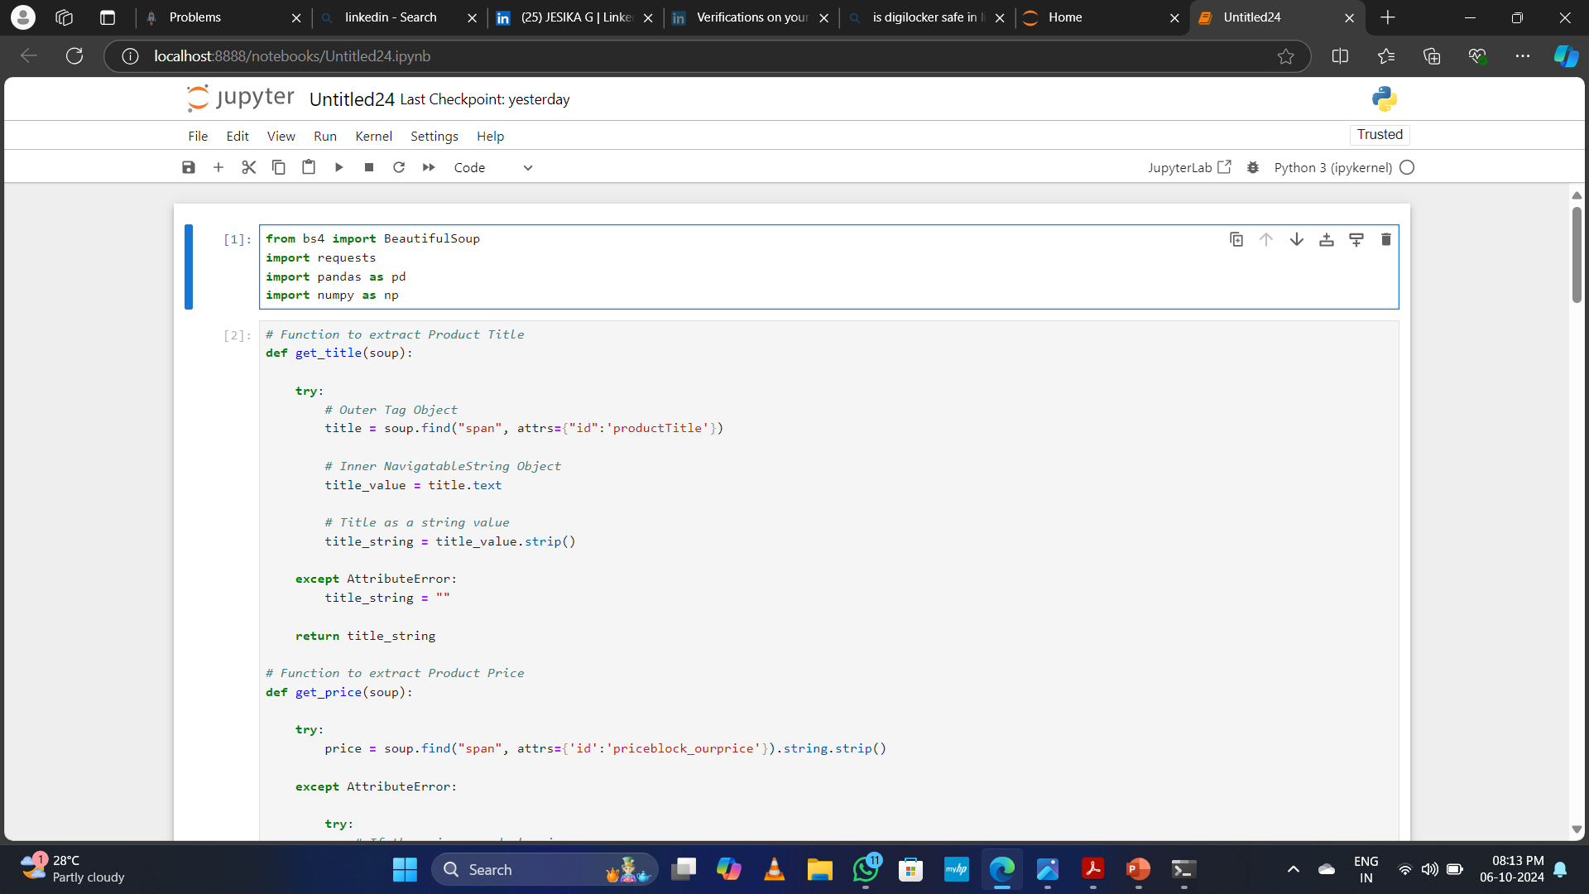
Code:

Slide 7
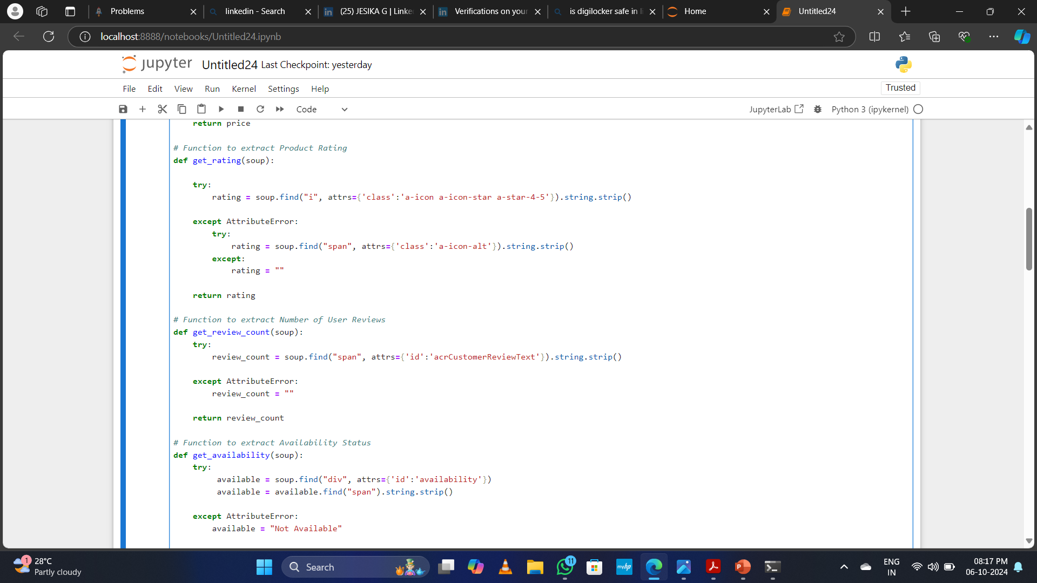

Slide 8
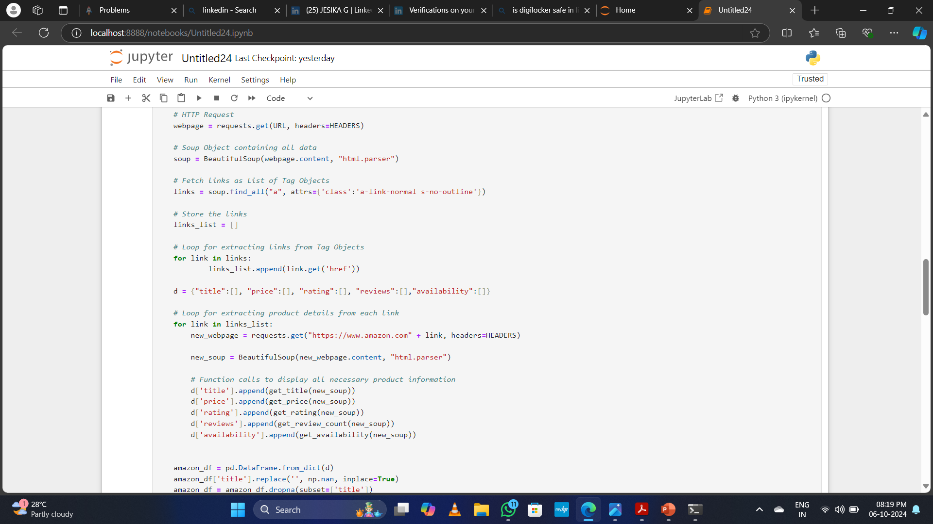

Slide 9
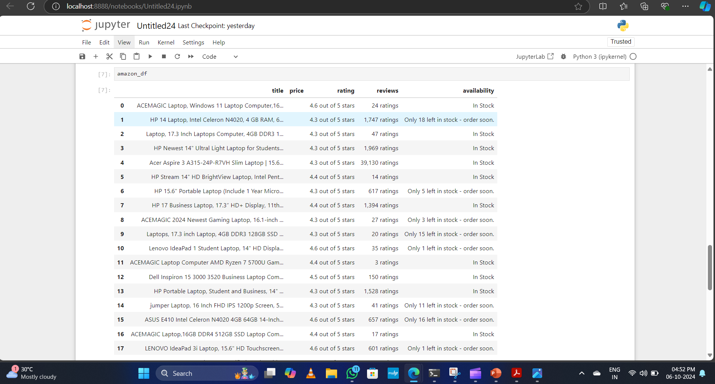
Output:

Slide 10
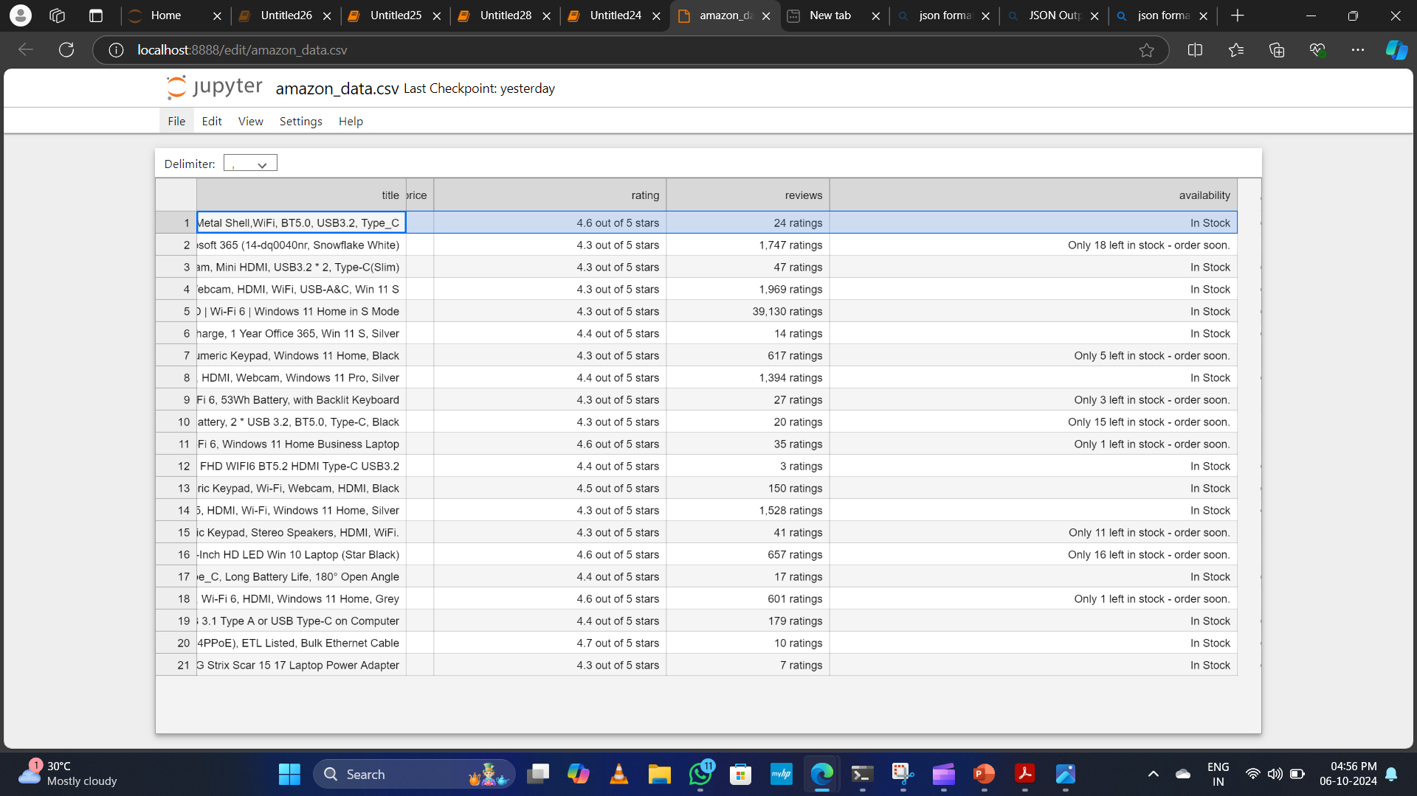
CSV file formate output:

Slide 11
Conclusion:
The Amazon Scraper project provides a streamlined solution for automating data collection from Amazon. It offers flexibility in extracting important product details that can be stored and analyzed for various business or personal needs.

Slide 12
Thank You all.

